Slide 1
Lesson 22 – Homework review

Slide 2
Context configuration ?
What about complexity? 🧐

Slide 3
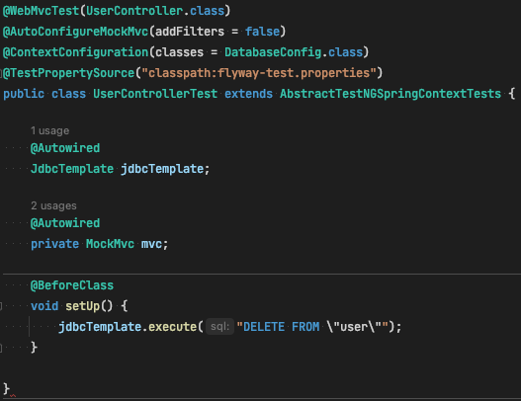
Complex config

Slide 4
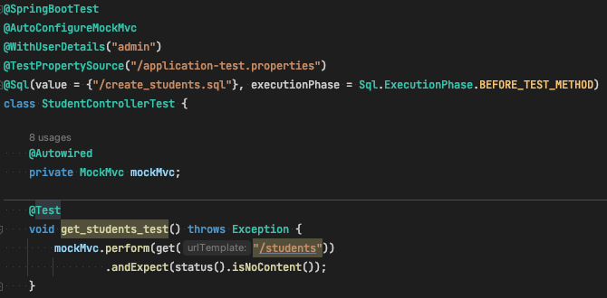
Complex config 2

Slide 5
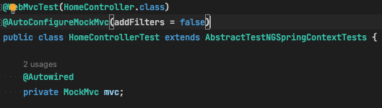
Ignoring of Security config

Slide 6
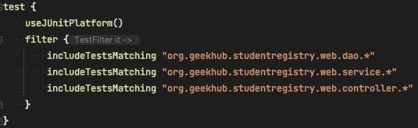
Wait but where is unit tests?

Slide 7
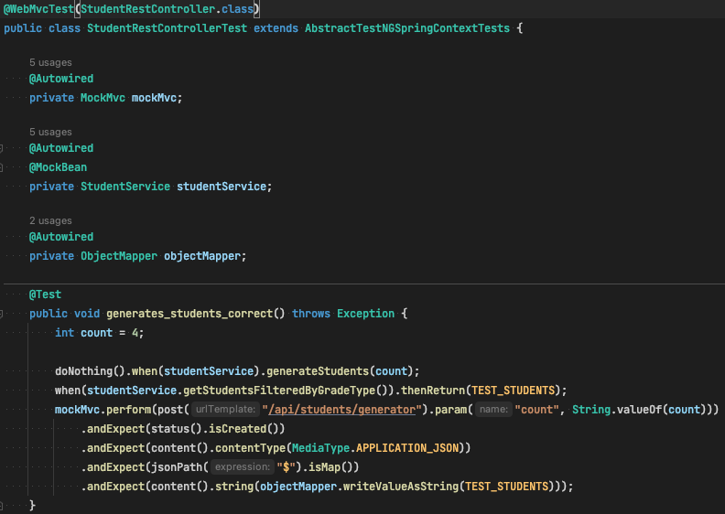
JSON Path vs ObjectMapper

Slide 8
Thanks!
Any Questions?
Or find us in Slack:
@Yaroslav Brahinets
@Vasya Rudas

